Slide 1
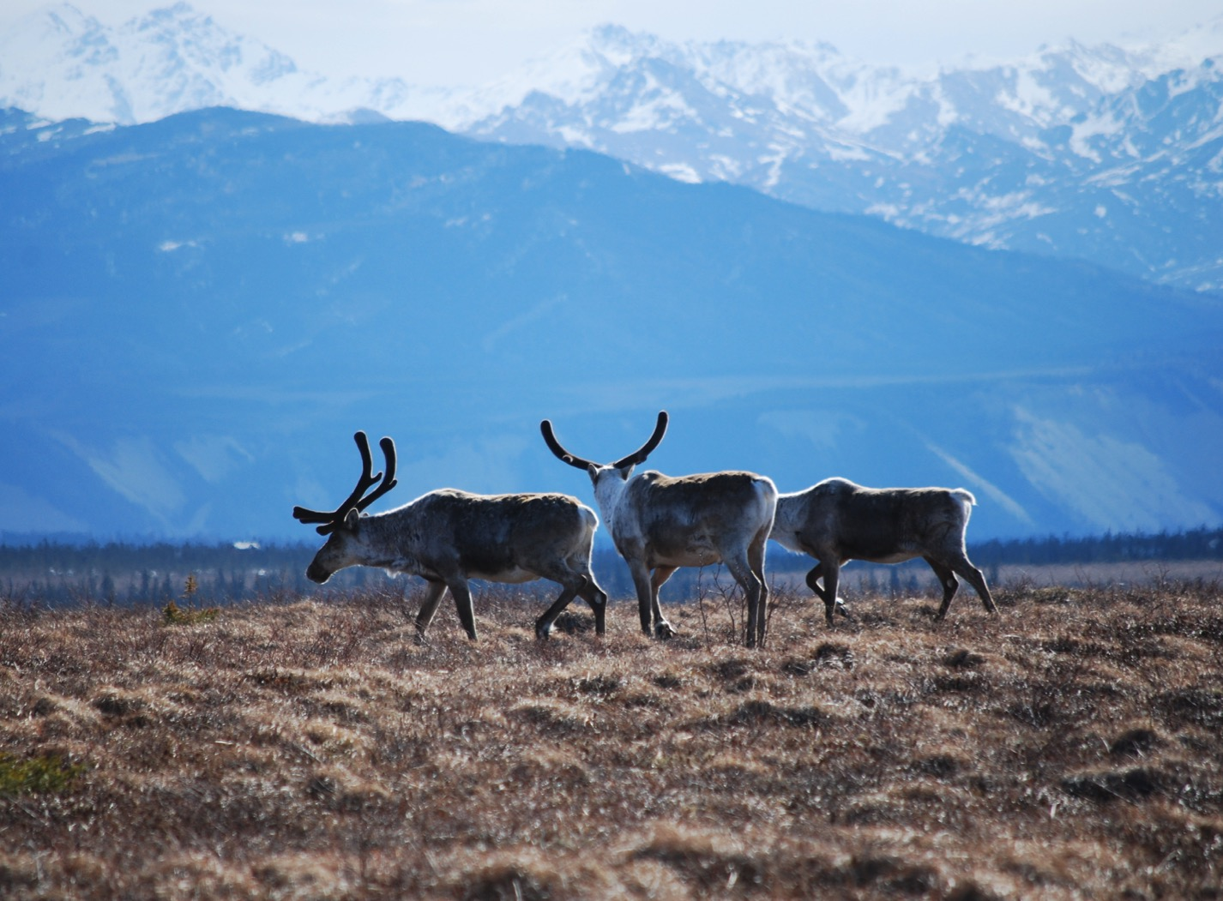
Arctic Boreal Vulnerability Experiment (ABoVE)
2018 ABoVE Airborne Flights
23 July 2018 (DOY 203)
AVIRIS-NG: Fairbanks Area
Charles Miller, Deputy Science Lead
Jet Propulsion Laboratory, California Institute of Technology
and the ABoVE Science Team
For Hank Margolis, Eric Kasichke, Bruce Tagg
NASA HQ
2018

Slide 2

23 July 2017/DOY 203
Fairbanks Area
Daily Status:
AVIRIS-NG / Dynamic Aviation B-200 (N53W)
REPORT DATE: 23 July 2018
Current Status of Aircraft: GREEN
Current Status of AVIRIS: GREEN
Current Deployment Location: Fairbanks AK (PAFA)
Crew: Heidt, Jones, Nolte, Sauture
Science Planning: A Thorpe
Data Processing: W Olsen-Duvall
Instrument Managers: M Eastwood, I McCubbin
Instrument PI: R Green
Science Lead: C Miller

Slide 3
23 July 2017/DOY 203
Fairbanks Area
Daily Summary:
Fairbanks – CPRW – Goldstream Valley – BNZ LTER – Fairbanks
Good flight
Notes:
Fairbanks Daily News-Miner had a story in todays paper about the 40-mile Caribou Herd
http://www.newsminer.com/features/sundays/alaska_science_forum/parting-a-sea-of-fortymile-caribou/article_6450bcf4-8b92-11e8-a192-3f5d81f497af.html

Slide 4
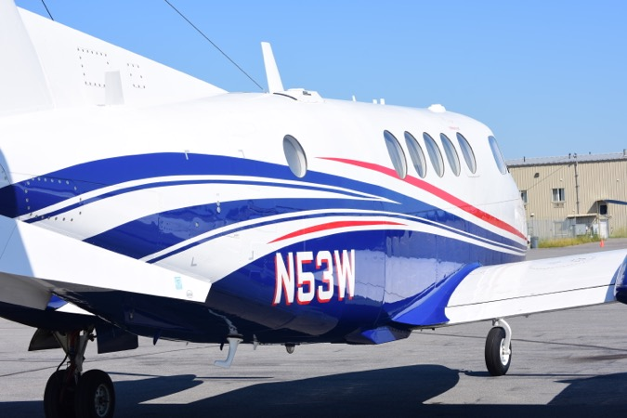
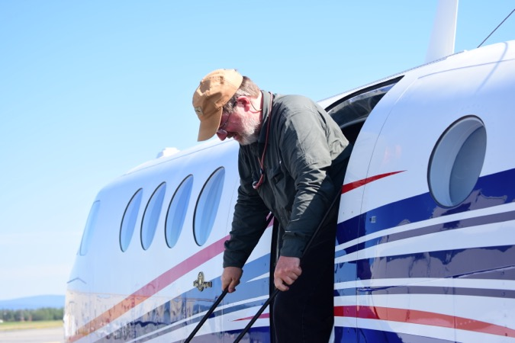
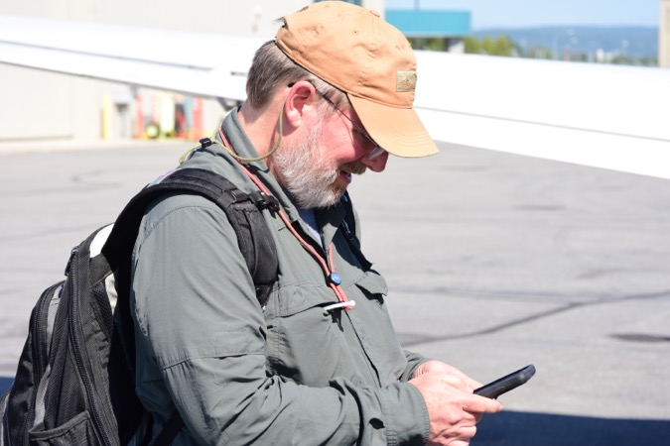
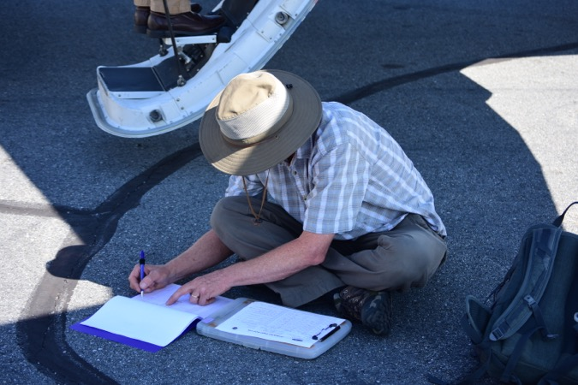
23 July 2017/DOY 203
Fairbanks Area

Slide 5
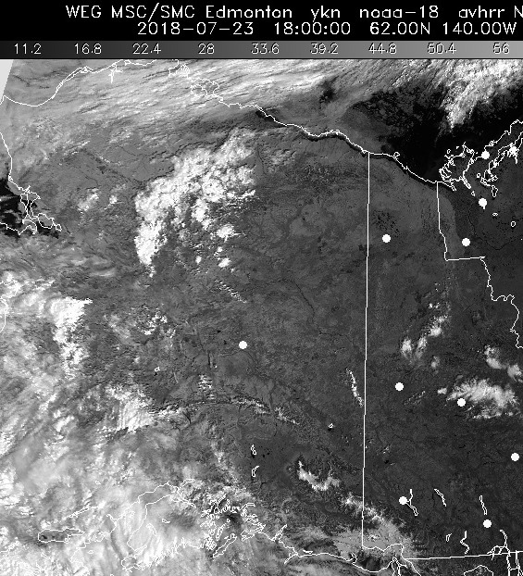
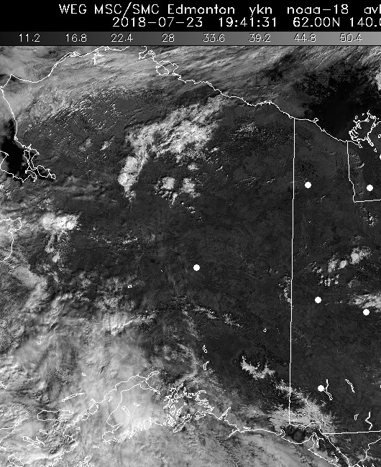
23 July 2017/DOY 203
Fairbanks Area
HRPT Vis 1941Z
HRPT Vis 1800Z

Slide 6
23 July 2017/DOY 203
Fairbanks Area
Fairbanks Area
Planned Lines

Slide 7
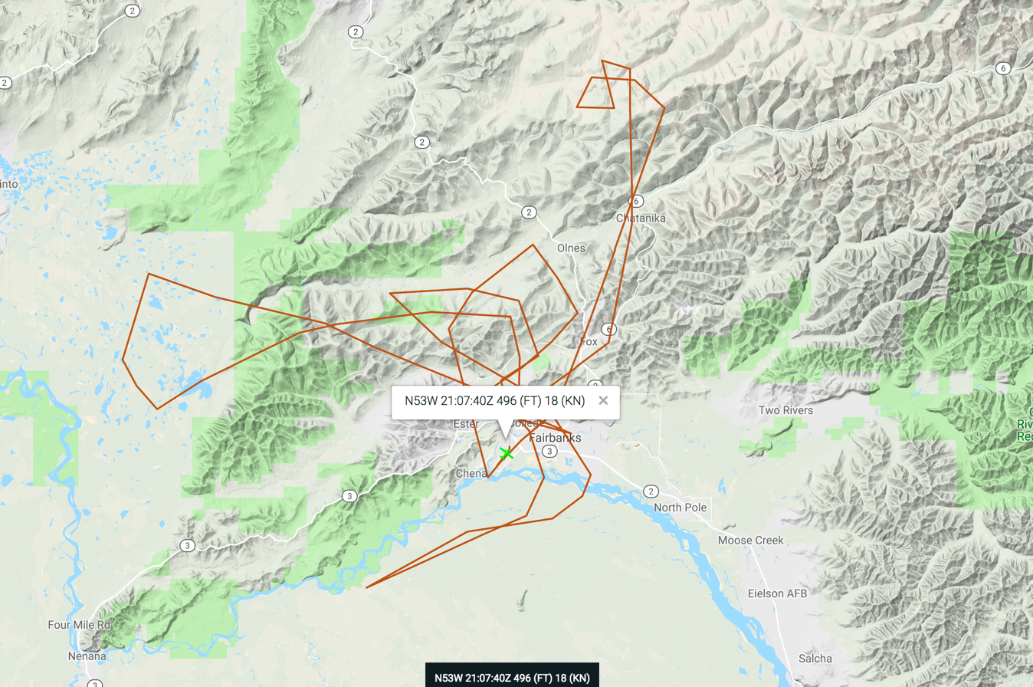
23 July 2017/DOY 203
Fairbanks Area
As-flown Lines
Actual
Flight Lines

Slide 8
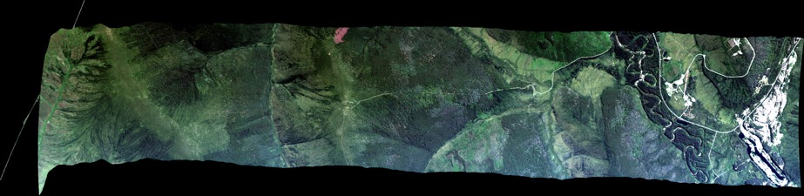
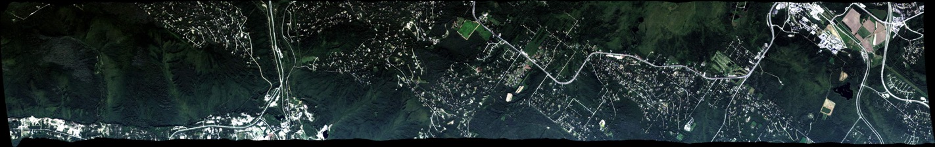
23 July 2017/DOY 203
Fairbanks Area
AVIRIS-NG Quick-look products
https://avirisng.jpl.nasa.gov/cgi/flights.cgi?step=view_flightlog&flight_id=ang20180723t
A. Line AVng_258A-Z, FL190, Run ID 193341: Fairbanks
B. Line AVng_254A-Z, FL183, Run ID 193953: Fairbanks
Winston Olson-Duvall, JPL
A
B
A. Cloud interference, especially at right edge
B. Yukon Flats wetlands
Notes:
A. #70 in Google Earth set
B. #55 in Google Earth set

Slide 9
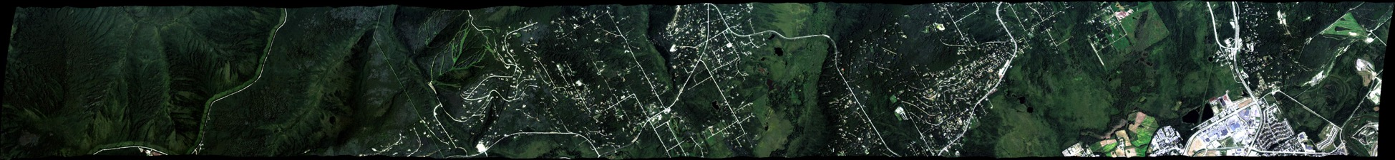
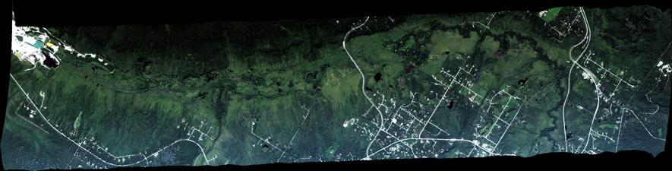
23 July 2017/DOY 203
Fairbanks Area
AVIRIS-NG Quick-look products
https://avirisng.jpl.nasa.gov/cgi/flights.cgi?step=view_flightlog&flight_id=ang20180723t
A. Line AB_CH4_L001, FL183, Run ID 194529: Fairbanks
B. Line AVng_253A-Z, FL183, Run ID 195338: Fairbanks
Winston Olson-Duvall, JPL
A
B
A. Big Trail Lake, Goldstream Lake, Donut Lake
B. Fairbanks
Notes:
A. #86 in Google Earth set
B. #xx in Google Earth set

Slide 10
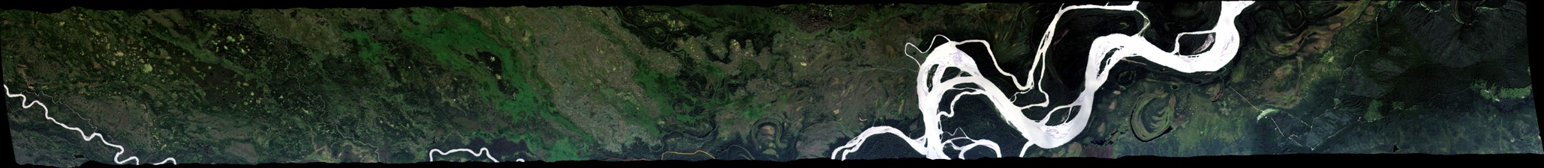
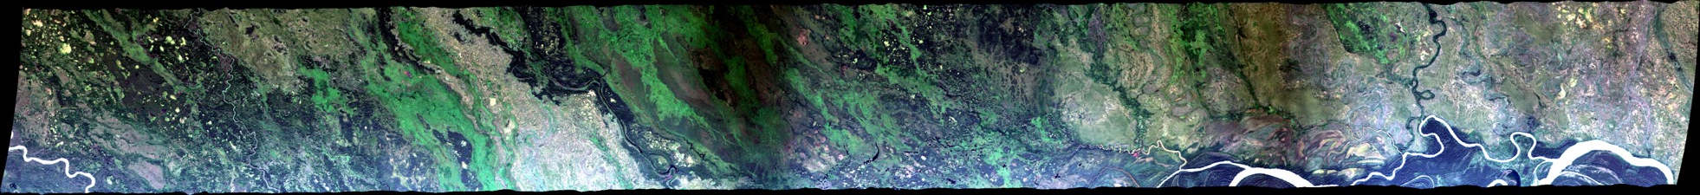
23 July 2017/DOY 203
Fairbanks Area
AVIRIS-NG Quick-look products
https://avirisng.jpl.nasa.gov/cgi/flights.cgi?step=view_flightlog&flight_id=ang20180723t
A. Line AVng_251A-Z, FL179, Run ID 200207: Fairbanks
B. Line AVng_252A-Z, FL179, Run ID 201102: Fairbanks
Winston Olson-Duvall, JPL
A
B
A. Bonanza Creek LTER
B. Tanana River fire scar
Notes:
A. #59 in Google Earth set
B. #60 in Google Earth set

Slide 11
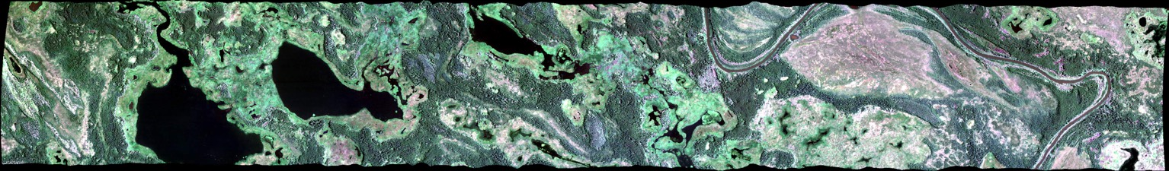
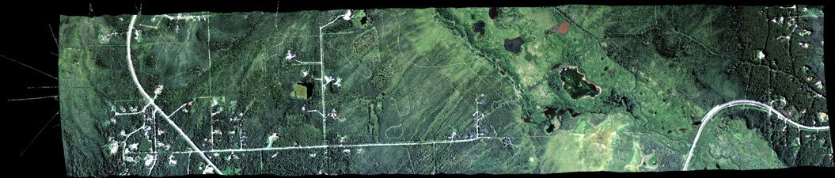
23 July 2017/DOY 203
Fairbanks Area
AVIRIS-NG Quick-look products
https://avirisng.jpl.nasa.gov/cgi/flights.cgi?step=view_flightlog&flight_id=ang20180723t
A. Line AB_CH4_L007, FL072, Run ID 202850: Fairbanks
B. Line AB_CH4_L002, FL072, Run ID 204128: Fairbanks
Winston Olson-Duvall, JPL
A
B
A. Minto Flats
B. Cranberry Lake, Big Trail Lake
Notes:
A. #92 in Google Earth set
B. #87 in Google Earth set

Slide 12
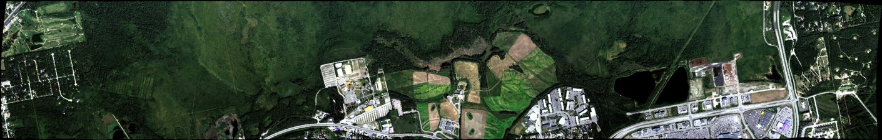
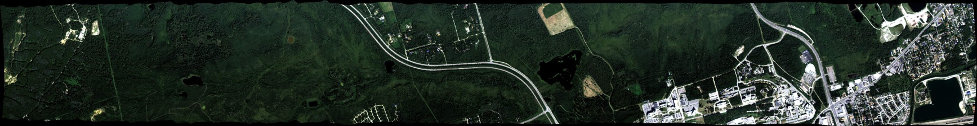
23 July 2017/DOY 203
Fairbanks Area
AVIRIS-NG Quick-look products
https://avirisng.jpl.nasa.gov/cgi/flights.cgi?step=view_flightlog&flight_id=ang20180723t
A. Line AB_CH4_L005, FL072, Run ID 204511: Fairbanks
B. Line AB_CH4_L004, FL072, Run ID 204900: Fairbanks
Winston Olson-Duvall, JPL
A
B
A. Creamer’s Field in center
B. Smith Lake
Notes:
A. #90 in Google Earth set
B. #89 in Google Earth set

Slide 13
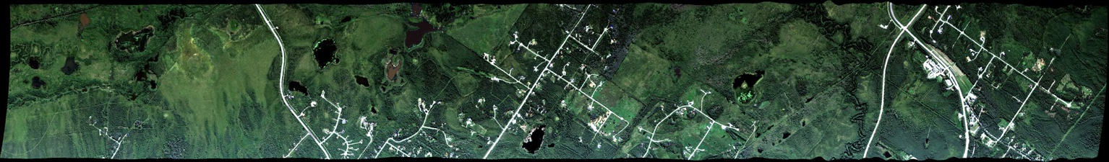
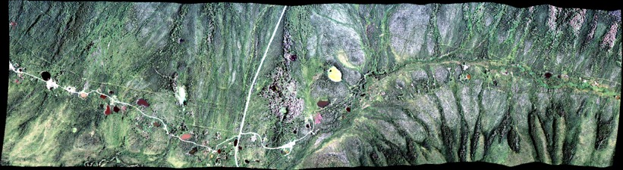
23 July 2017/DOY 203
Fairbanks Area
AVIRIS-NG Quick-look products
https://avirisng.jpl.nasa.gov/cgi/flights.cgi?step=view_flightlog&flight_id=ang20180723t
A. Line AB_CH4_L003, FL072, Run ID 205227: Fairbanks
B. Line AB_CH4_L006, FL072, Run ID 205626: Fairbanks
Winston Olson-Duvall, JPL
A
B
A. Big Trail Lake, Goldstream Lake, Donut Lake
B. Caribou – Poker Creek
Notes:
A. #88 in Google Earth set
B. #91 in Google Earth set

Slide 14
Backup

Slide 15
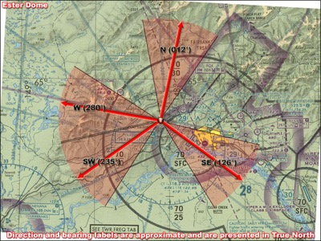
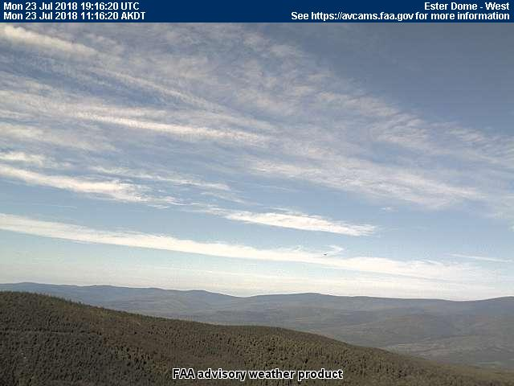
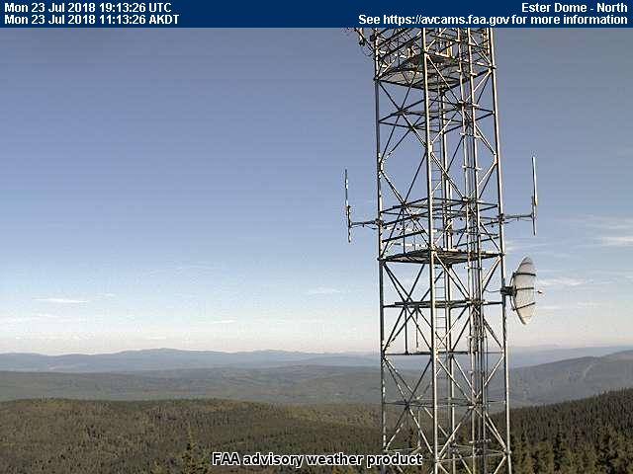
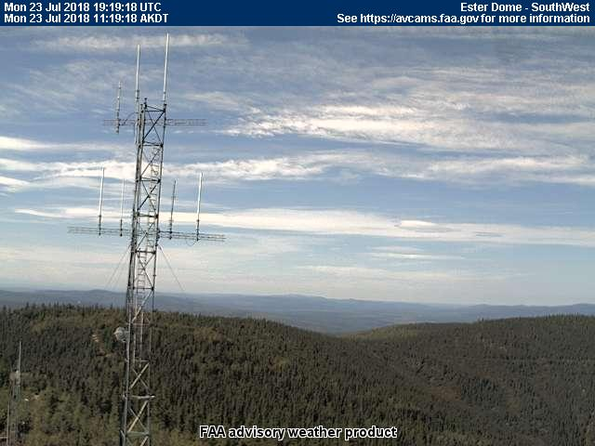
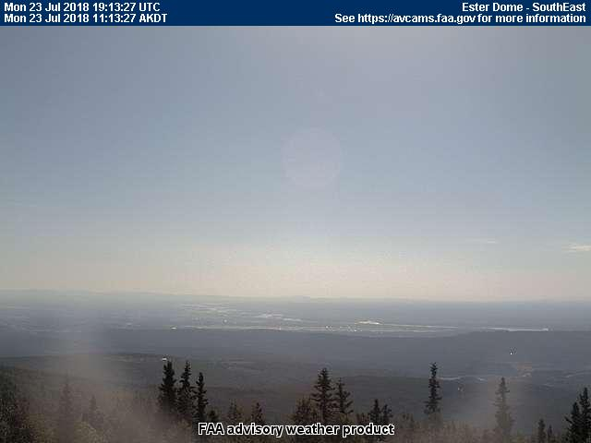
23 July 2017/DOY 203
Fairbanks Area
Esther Dome
1119 AKDT/1919 UTC

Slide 16
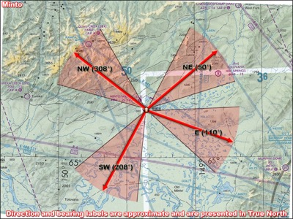
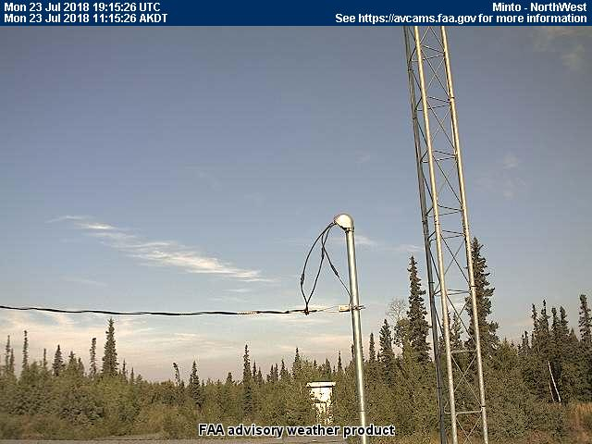
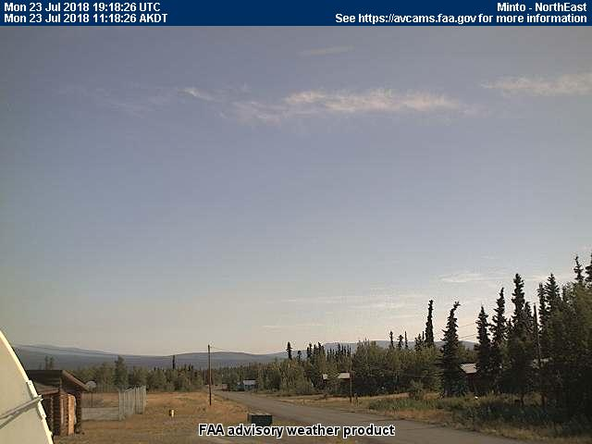
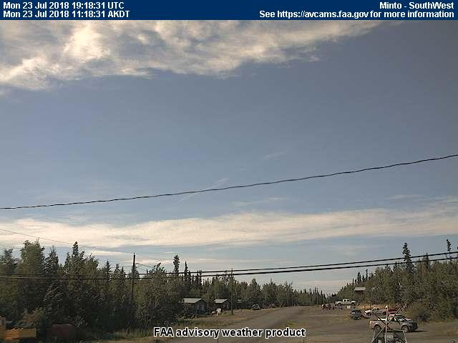
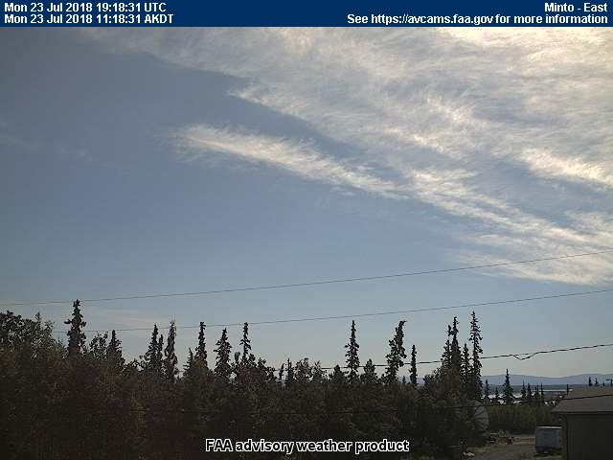
23 July 2017/DOY 203
Fairbanks Area
Minto
1118 AKDT/1918 UTC

Slide 17
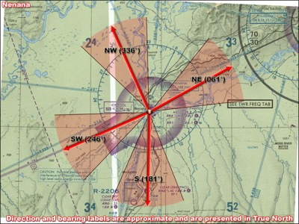
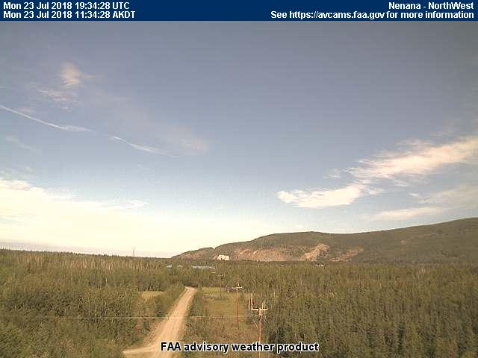
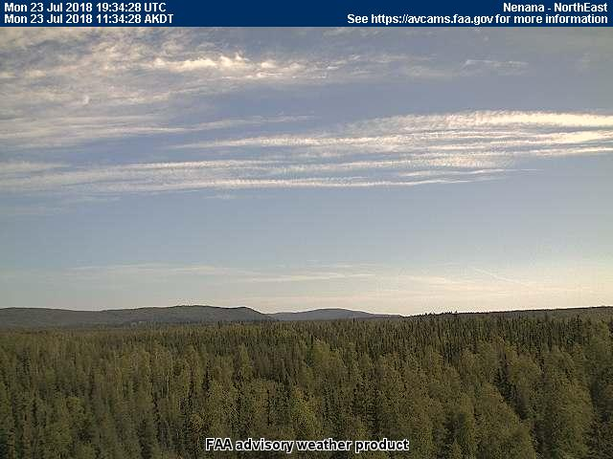
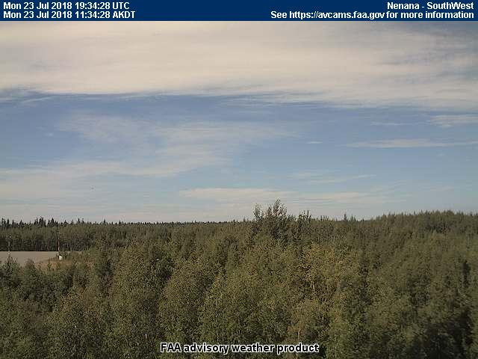
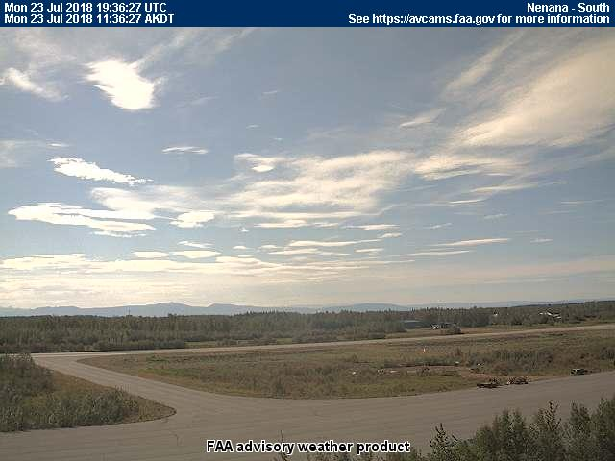
23 July 2017/DOY 203
Fairbanks Area
Nenana
1134 AKDT/1934 UTC

Slide 18
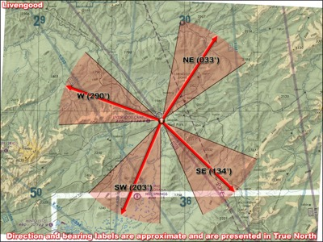
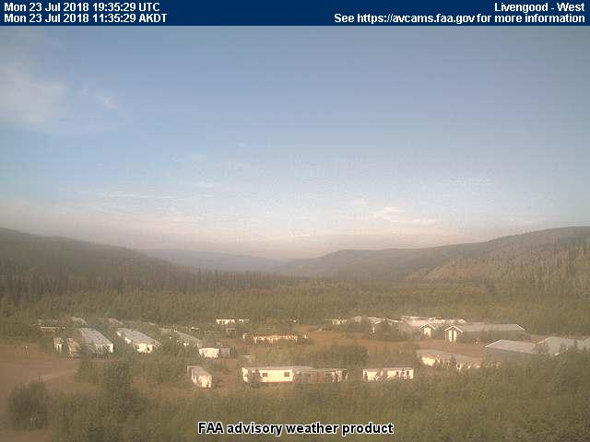
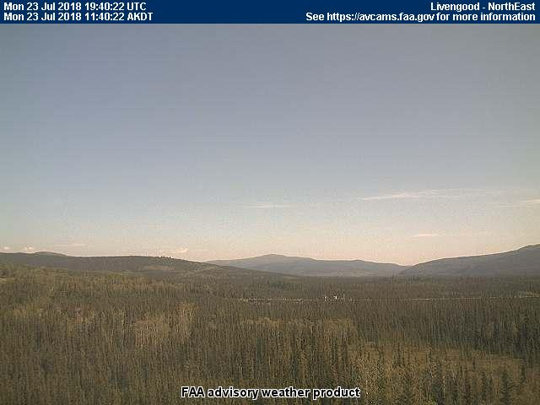
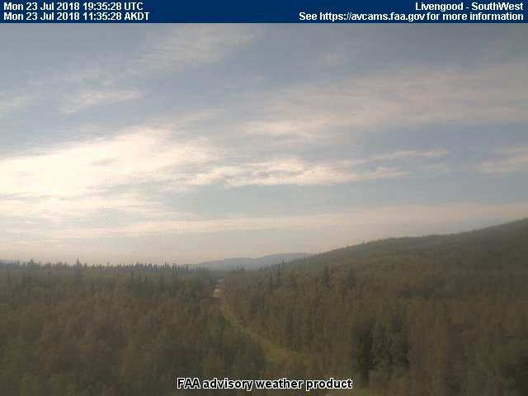
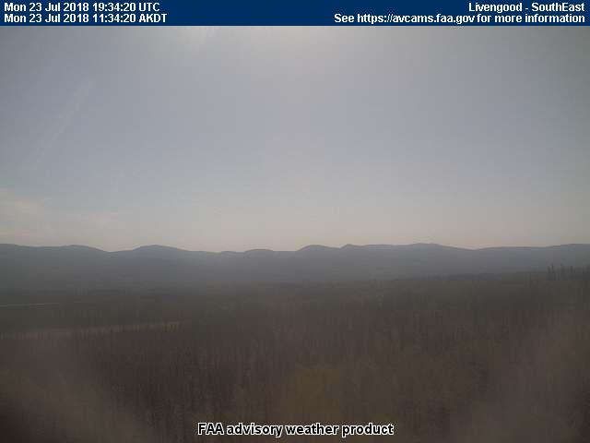
23 July 2017/DOY 203
Fairbanks Area
Livengood
1140 AKDT/1940 UTC

